Slide 1
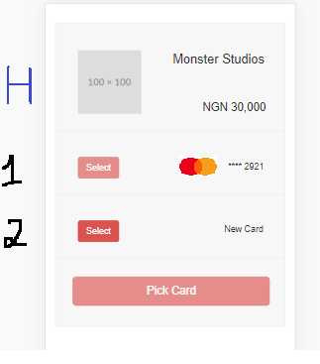
Landing Page for Card Payment form
Select Tab: Idle state is inactive becomes active on user click
On user select CTA Buttom “Pick Card” becomes active with display text changed to “Pay Amount” e.g Pay N 30000
On user select CTA buttom “Pick Card” becomes active with display text changed to “NEXT”
New Card text color #5cb85c
Header higligted in blue remain
visible for either user flow for 1 or 2

Slide 2

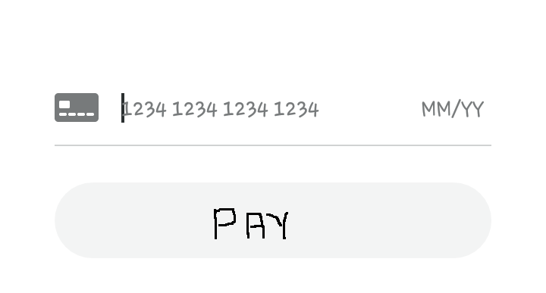

2.) NEW CARD UX
CTA buttom: “PAY” inactive until user provides card pan, Exp date and CCV (Form 1st layer)
PIN form Section displayed next (Form 2nd layer)
CTA buttom: “Enter PIN”
Inactive until user 4 digit numeric value
OTP form section displayed next (Form 3rd layer)
CTA buttom: “Enter OTP”
Inactive until until user provides 6 digit numeric value
UX video description for form animation appicable to “Form 1st layer”
https://drive.google.com/file/d/1KIXzxJbZRrPI_HRxUDn7_fmyTjI9ZoVC/view?usp=sharing
Tab for saved card payment 1 should be hidden when users select’s option for 2 and proceed’s to provide card info

Slide 3
SUCCESS LAYOUT
Elements
Success Icon
Display Message
Close buttom
Part of form layout, Not a pop up or alert notification

